Slide 1

CUSTOMER PERSONALITY ANALYSIS USING MACHINE LEARNING INTERNSHIP REPORT Submitted by SOUMEN CHATTERJEE EC2432251010407 JAN 2024 MCA Batch MAY-JUNE 2025 Exam (3rd SEM) DIRECTORATE OF ONLINE EDUCATION SRM INSTITUTE OF SCIENCE AND TECHNOLOGY KATTANKULATHUR- 603 203

Slide 2
Agenda
1. Abstract
2. Introduction
3. System Analysis
5. Module Description
6. Design
7. Implementation
8. Testing
9. Output Screens
10. Tools and Technologies
11. Conclusion
12. Appendices - CODES
13. References

Slide 3

Abstract
Conducted a Machine Learning project on Customer Personality Analysis using a marketing dataset.
Goal: Understand customer behavior and segment customers for better-targeted marketing strategies.
Used data preprocessing, EDA, and feature selection techniques to prepare data.
Applied K-Means clustering algorithm to segment customers based on spending behavior.
Visualized clusters to interpret customer traits for marketing decision-making.
Project contributes to data-driven approaches in customer relationship management.

Slide 4

Introduction​
Background
Modern businesses face challenges understanding diverse customer behaviors.
Customer data holds valuable insights for crafting personalized marketing strategies.
Problem Statement
Lack of effective segmentation leads to generic marketing and lower customer engagement.
Companies struggle to target the right audience based on behavior and preferences.

Slide 5
Introduction​
Planned Solution
Analyze customer data using Machine Learning techniques.
Apply K-Means Clustering to segment customers by personality traits and spending patterns.
Enable data-driven, targeted marketing decisions for better customer retention and ROI.

Slide 6
System Analysis
Existing System
Customer segmentation often done manually or with basic tools.
Lacks intelligent analysis of behavioral and demographic data.
Results in generic marketing and poor ROI.
Proposed System
Automates customer analysis using Machine Learning (K-Means Clustering).
Segments customers based on spending score, income, age, etc.
Offers actionable insights for marketing strategy refinement.

Slide 7
System Analysis
Benefits
Improves targeted marketing and customer satisfaction.
Enables data-driven decision-making.
Helps businesses reduce marketing waste and improve customer retention.
Feasibility Study
Technical Feasibility: Tools like Python, Pandas, Scikit-learn, and Jupyter Notebook are available and efficient.
Operational Feasibility: System is easy to use and interpret for business users.
Economic Feasibility: Cost-effective solution using open-source technologies.

Slide 8
Module Description
1. Data Collection Module
Collects data from a marketing campaign dataset.
Includes fields like age, income, spending score, marital status, etc.
2. Data Preprocessing Module
Handles missing values and data cleaning.
Performs feature selection and scaling for model readiness.
3. Exploratory Data Analysis (EDA) Module
Visualizes distributions and relationships (e.g., via histograms, pair plots).
Identifies patterns and correlations in customer data.

Slide 9
Module Description
4. Clustering Module
Uses K-Means Clustering algorithm for customer segmentation.
Groups customers into distinct clusters based on behavior and traits.
5. Visualization & Result Interpretation Module
Displays clusters with visual tools (scatter plots, cluster graphs).
Helps derive business insights from customer segments.
6. Model Evaluation Module
Validates clusters using methods like Elbow Method.
Ensures optimal number of clusters for actionable results.

Slide 10
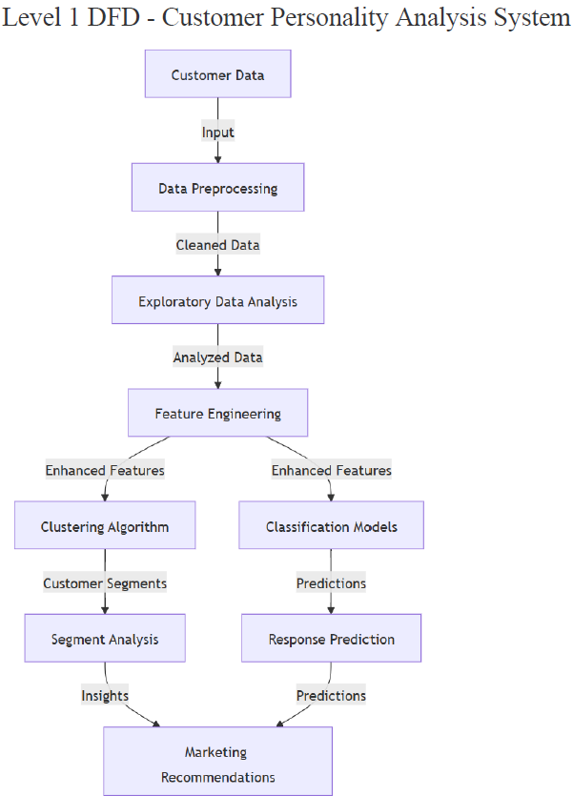
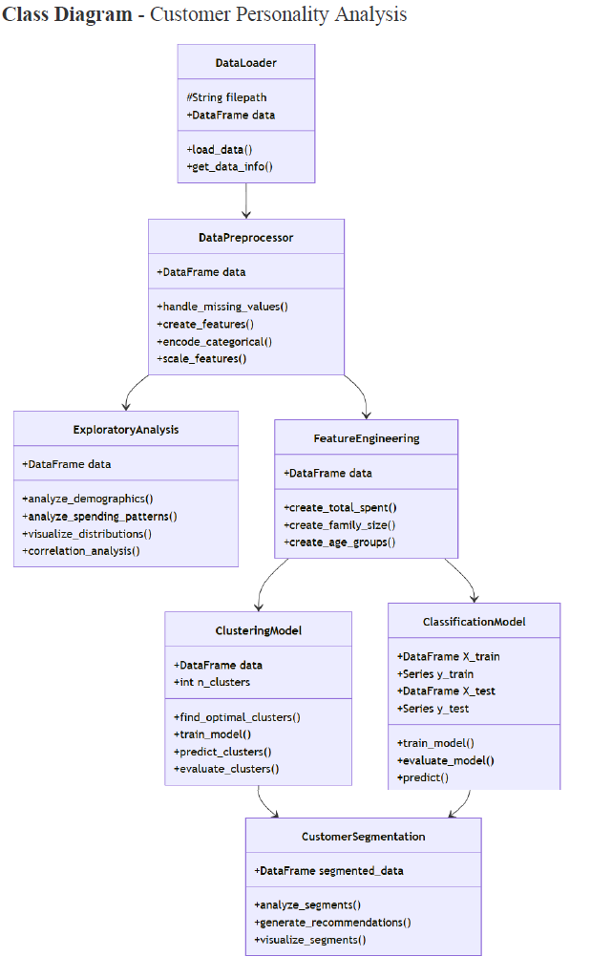
Design

Slide 11
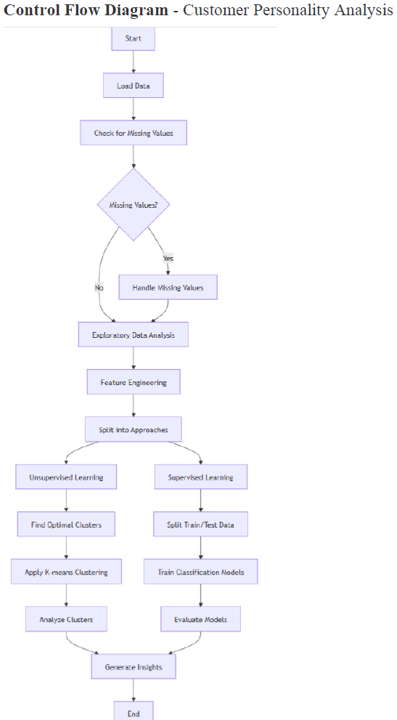
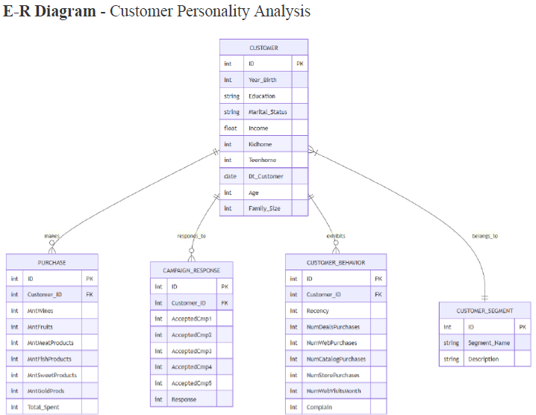
Design​

Slide 12

Implementation
Stages of Implementation
Data Collection: Imported dataset from .csv format.
Data Preprocessing: Handled nulls, scaled features, selected relevant fields.
Exploratory Data Analysis (EDA): Visualized data trends and patterns.
Model Building: Applied K-Means Clustering to segment customers.
Evaluation & Visualization: Used Elbow Method and plotted results for interpretation.
Software Reuse and Libraries Used
Python Libraries:
pandas, NumPy – Data handling
matplotlib, seaborn – Data visualization
sklearn – ML model (K-Means, scaling, Elbow Method)

Slide 13
Implementation
Special Tools Used
Jupyter Notebook – Development and testing environment.
Python – Core programming language.
Scikit-learn – Machine Learning toolkit.
Design Patterns and Coding Techniques
Followed modular programming for clarity and reusability.
Used functions and structured code blocks for each ML stage.
Maintained clean and well-commented code for readability.

Slide 14
Implementation
Data Transformation & Preprocessing Techniques
Handled missing values and outliers.
Performed feature scaling using StandardScaler.
Converted categorical data to numerical formats where required.
Model Implementation Summary
Implemented K-Means Clustering to group similar customers.
Determined optimal clusters using the Elbow Method.
Plotted clusters to extract insights for marketing strategies.

Slide 15
Testing
Testing Approach
Verified data integrity after preprocessing and transformations.
Ensured models performed as expected using validation techniques.
Types of testing applied:
Unit Testing: For data cleaning and feature engineering functions.
Data Validation Testing: Checked null handling and data consistency.
Functional Testing: Verified full pipeline execution (EDA to modeling).
Model Evaluation Testing: Compared predicted vs. actual outcomes.
Test Plans
Validated pipeline in Jupyter Notebook cell-by-cell.
Accuracy of classification models measured using performance metrics.
Visualization outputs manually checked for interpretability and correctness.

Slide 16
Testing
Lessons Learnt from Testing
Early testing helped avoid issues during model building.
Detected data imbalance and feature skew, influencing accuracy.
Importance of regular data-type and null-value checks in ML workflows.
Random Forest emerged as the most reliable classifier (~90.4% accuracy).
Summary
Comprehensive testing ensured model reliability and valid insights.
Testing helped improve preprocessing steps and model tuning.
Results supported business use-case readiness of the final ML pipeline.

Slide 17
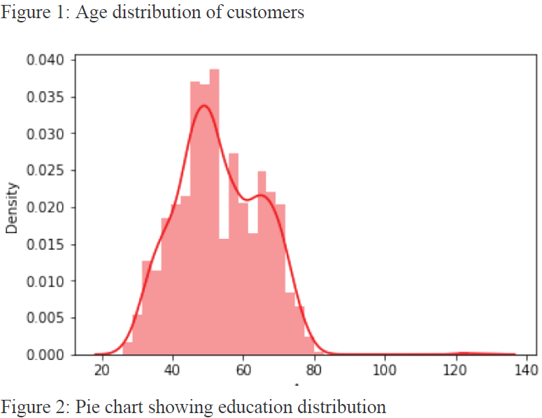
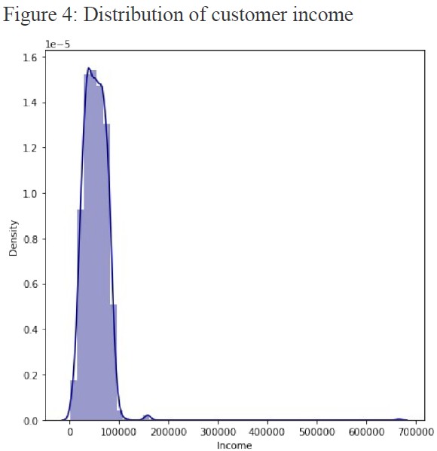
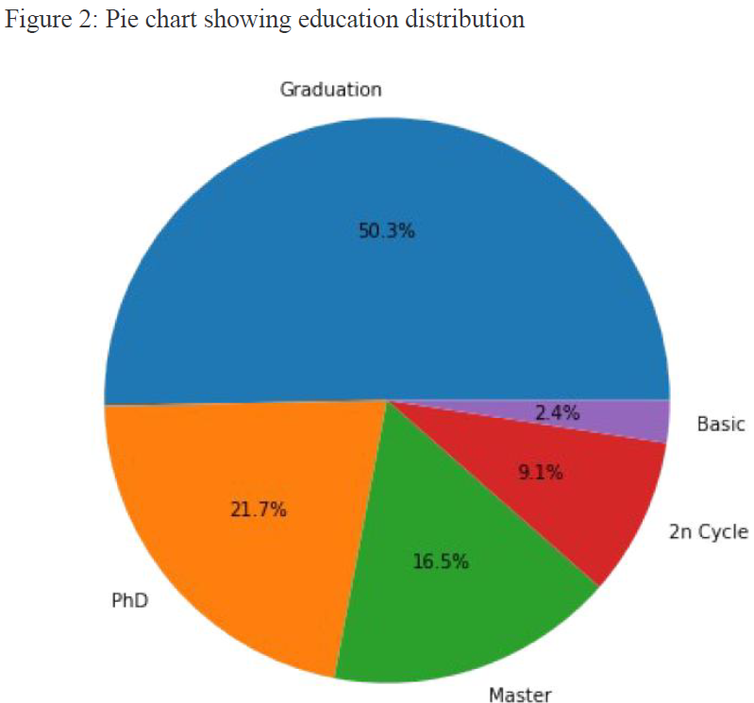
Output Screens​

Slide 18
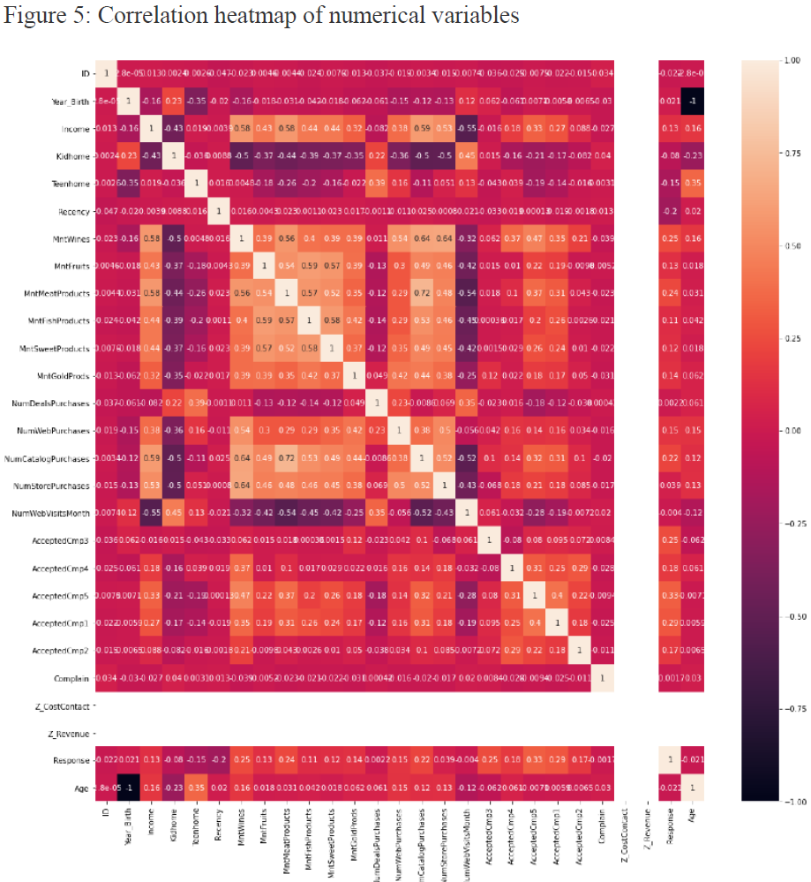
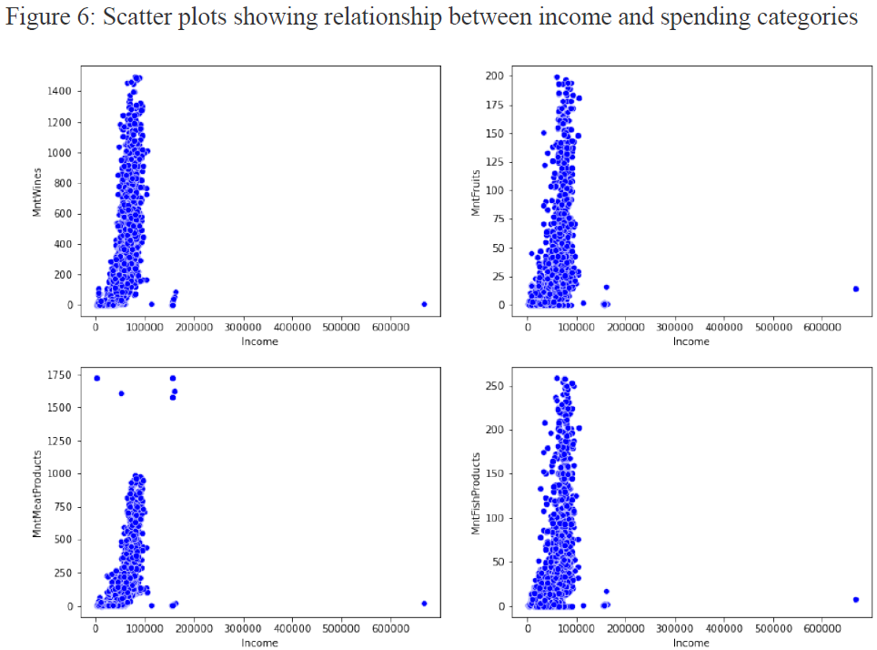
Output Screens​

Slide 19
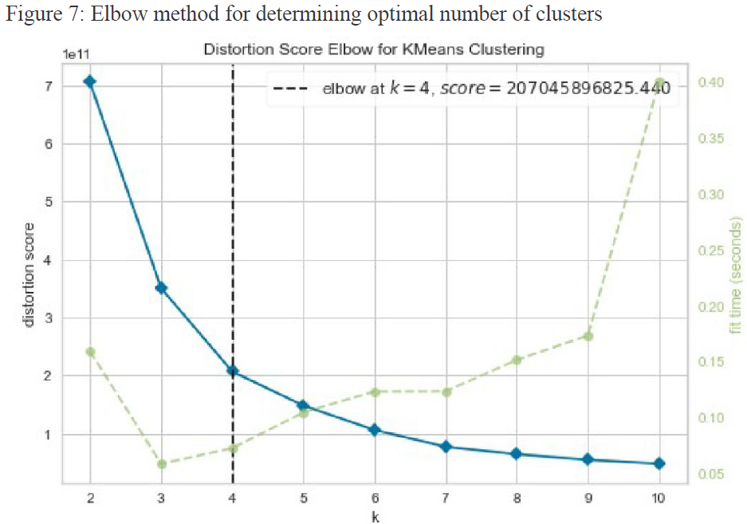
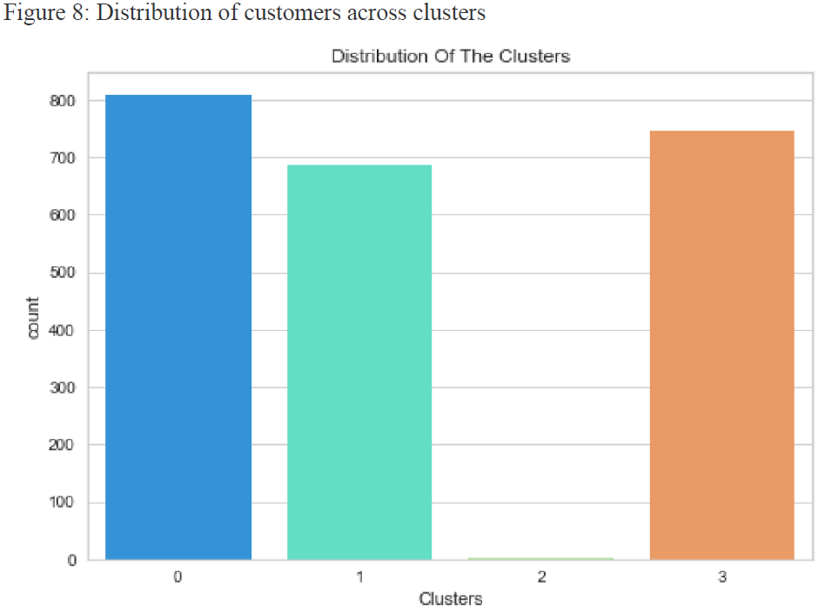
Output Screens​

Slide 20
Tools & Technologies
Programming Language
Python 3.x – Core language for data analysis and machine learning.
Data Analysis & Manipulation
Pandas – Data wrangling, cleaning, and transformation.
NumPy – Numerical operations and statistical functions.
Data Visualization
Matplotlib – Basic charting and plotting.
Seaborn – Advanced and aesthetic statistical visualizations.
Yellowbrick – Visual model evaluation (e.g., Elbow Method).

Slide 21
Tools & Technologies
Machine Learning
Scikit-learn (sklearn) – Algorithms for:
Clustering (K-Means)
Classification (Decision Tree, KNN, Random Forest)
Preprocessing (StandardScaler, LabelEncoder)
Model evaluation and validation
Development Environment
Jupyter Notebook – Interactive IDE for coding, testing, and documentation.
Anaconda – Python distribution with pre-installed ML/data libraries.

Slide 22
Tools & Technologies
Version Control
Git – Source control for tracking changes and project collaboration.
Database
CSV File Format – Used for storing and loading customer marketing data.
Methodologies
EDA (Exploratory Data Analysis) – To identify trends and distributions.
Feature Engineering – Created new features (Age, Total_Spent, Family_Size).
Unsupervised Learning – Customer segmentation using K-Means.
Supervised Learning – Response prediction using classification models.
Cross-validation – Ensured reliable and unbiased model evaluation.

Slide 23
Conclusion​
Summary & Key Achievements
Successfully analyzed customer data using Machine Learning techniques.
Implemented K-Means Clustering to segment customers into 4 behavior-based groups.
Built classification models (Decision Tree, KNN, Random Forest) for response prediction.
Achieved ~90.4% accuracy using Random Forest Classifier.
Extracted actionable insights for targeted marketing and personalization.

Slide 24
Conclusion​
Limitations
Dataset was static and limited in scope (no regional/time-series data).
Inconsistencies in categorical values (e.g., marital status) needed manual correction.
Deep learning models were not explored due to time and resource constraints.
Lessons Learnt
Preprocessing and feature engineering significantly impact model performance.
EDA combined with domain knowledge improves feature relevance.
Gained practical experience with multiple ML algorithms and business data handling.

Slide 25
Conclusion​
Further Enhancements / Recommendations
Integrate time-series data to track customer behavior over time.
Enrich dataset with external sources (e.g., web interactions, geographic info).
Apply dimensionality reduction (e.g., PCA, t-SNE) for better clustering.
Explore advanced ML models like XGBoost, LightGBM, and Neural Networks.
Build an interactive dashboard (Power BI, Tableau) for real-time insights.

Slide 26
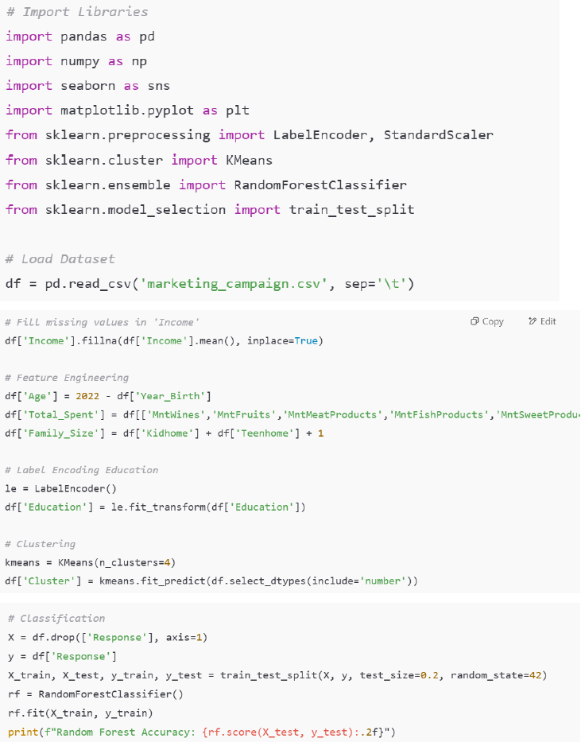
Appendices - Code
GitHub Link for Project files

Slide 27
References
Books & Publications:
Hands-On Machine Learning with Scikit-Learn, Keras, and TensorFlow by Aurélien Géron.
Scikit-learn: Machine Learning in Python by Pedregosa et al., Journal of Machine Learning Research.
Dataset Source:
Marketing Campaign Dataset provided for academic/educational use.
Official Documentation:
Scikit-learn
Pandas
Seaborn
Matplotlib
Online Resources:
Kaggle – for dataset reference and EDA ideas.
Towards Data Science – for ML tutorials and best practices.

Slide 28
THANK YOU

